Slide 1

Smart CPQ solution Kickoff
Ashford, UK
January 15th 2019

Slide 2
Agenda Kick Off Day One
1
[09:00 – 9:30] Introductions and Project Roles (All)
2
[9:30 – 10:30] Business Situation, Complications, Impact and Solution (Mark Petit)
3
[10:30 – 12:00] PROS SmartCPQ overview & demo (Thomas) & LTI MS Dynamics workflow (Rajen)
4
[12:00 – 13:00] Lunch (All)
5
[13:00 – 17:00] Quoting/CPQ Initial Solution Design Workshop (Jason)

Slide 3
PROS Team
Name | Role
Chris Causey | Account Manager
Thomas Drescher | Strategic Consultant
Pavan Sirsi | Delivery Executive
Simon Crisp | Project Manager
Jason Day | Solution Architect

Slide 4
The Role of the Professional Services Team
Name & Role | Responsibilities
Delivery Executive | Oversees delivery quality of project Assists with resolving issues and risk mitigation approaches Facilitates monthly steering meetings
Project Manager | Daily facilitator of project activities, daily project contact for the client Maintains project management assets – plan, scorecard, issues and lists of risks, etc. Coordinates PROS resources Facilitates weekly scorecard meetings Ensures timely sign-off of deliverables
Solutions Architect | Facilitates user and stakeholder interviews to understand current and future processes Develops solution design document Reviews configuration throughout the Project to ensure quality
Implementation Consultants | Facilitates data gathering sessions Configures the Product according to solution design Performs segmentation work
Other PROS Teams, Technology SAP Experts Cloud Infra Security etc.. | All marked teams are working internally (or if needed would provide an expertise to the customer) where and when it is necessary for the successful project implementation Change Management Security required during Sprint releases to TEST & PROD environments.

Slide 5
LTI Team
Name | Role
Rajen Shah | CPQ Functional Consultant
Rahul Pardeshi | Technical Lead
Pragathi | Technical Resource

Slide 6
Chubb Team
Name | Role

Slide 7
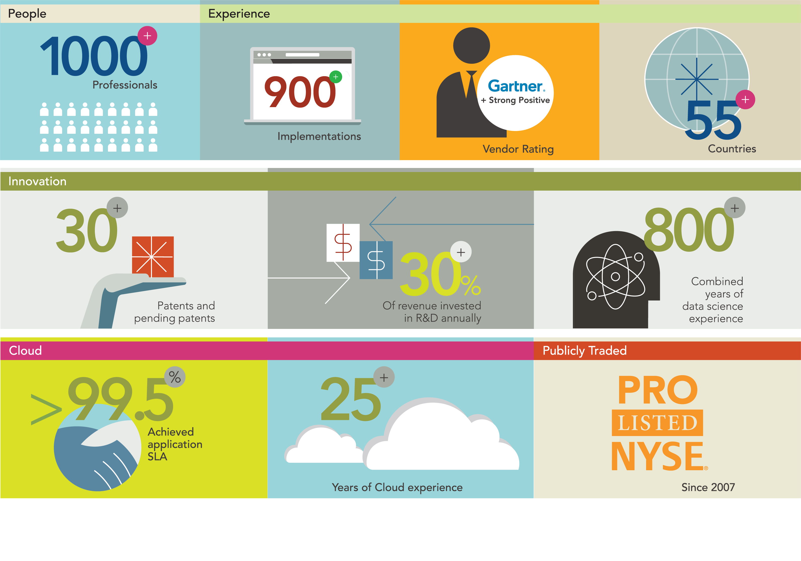
PROS Quick Facts

Slide 8
Project Scope
Search, compare and sell standard products and services
Build and manage business rules for configuring products for selling
Generate a 100% reliable quote in a few minutes for customer delivery
Leverage Chubb-provided discount guidance
Generate branded sales proposals
Attach images and PDF and other documents to catalog items
Set price and allowable discounts for each standard catalog item

Slide 9
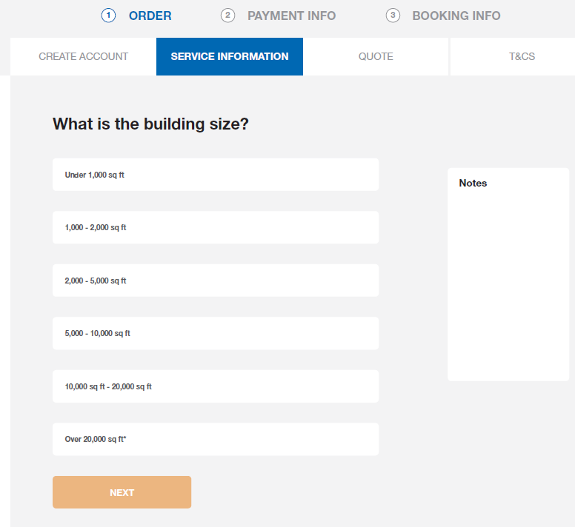
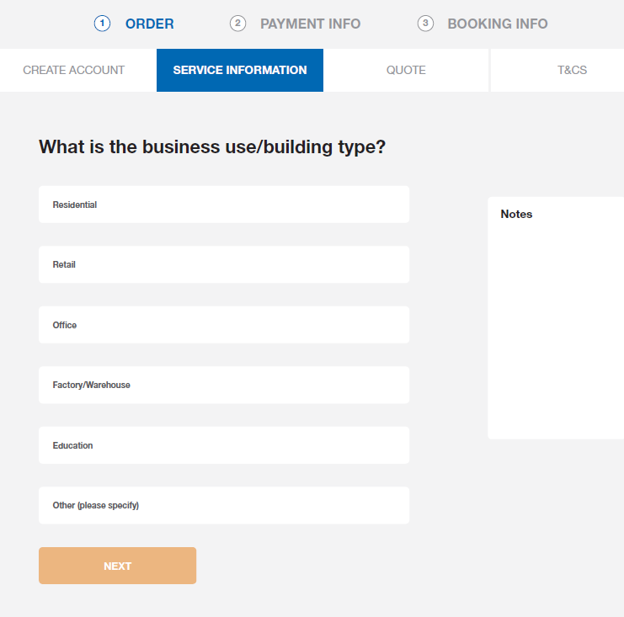
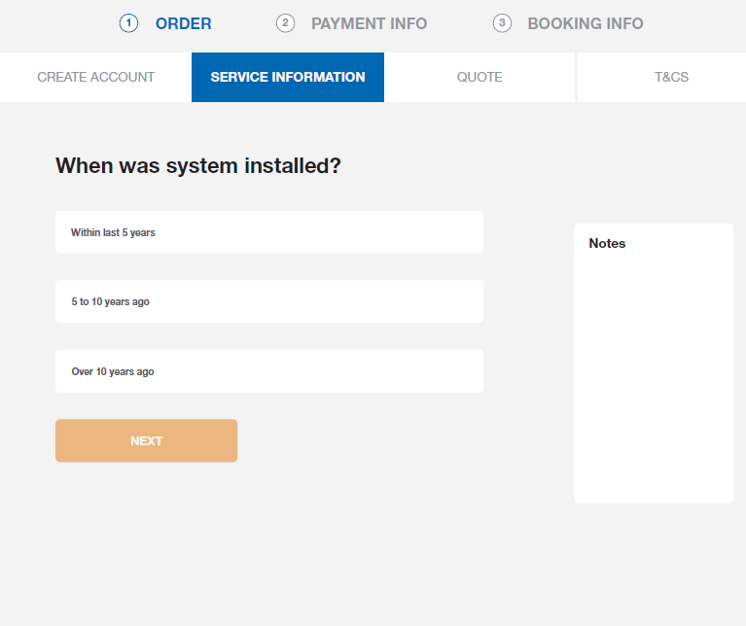
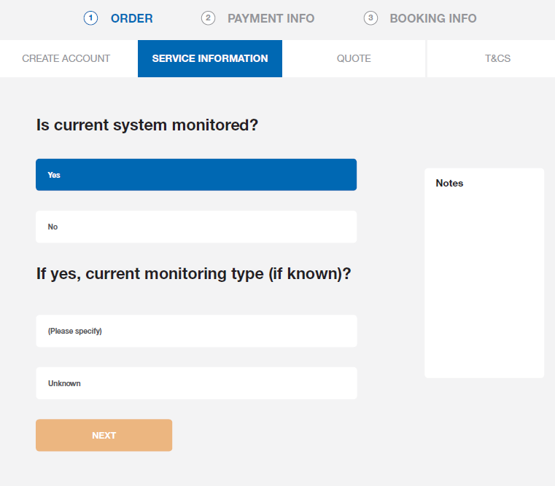
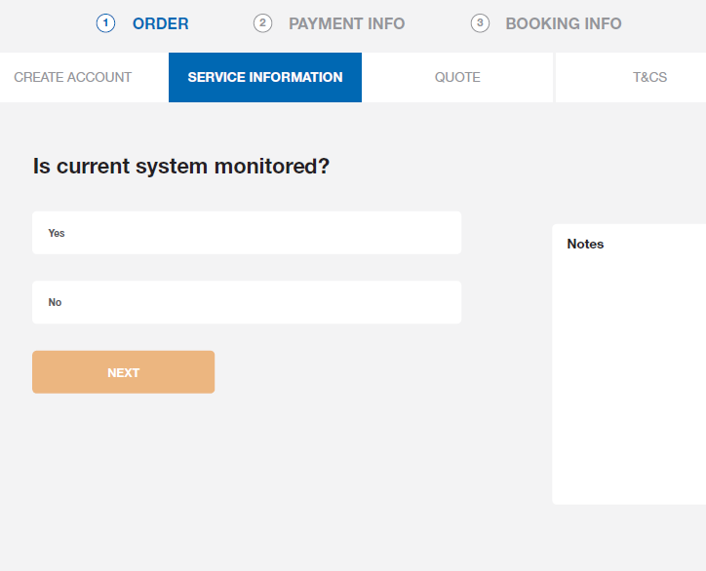
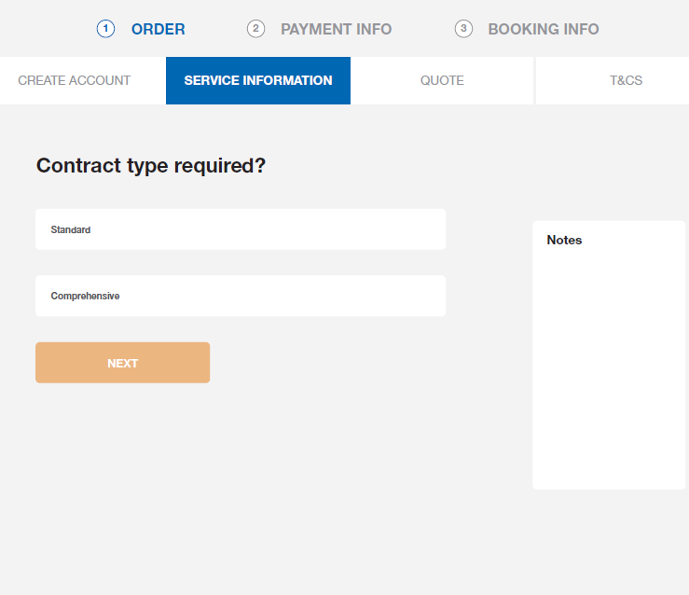
Proposed Purchase Flow

Slide 10
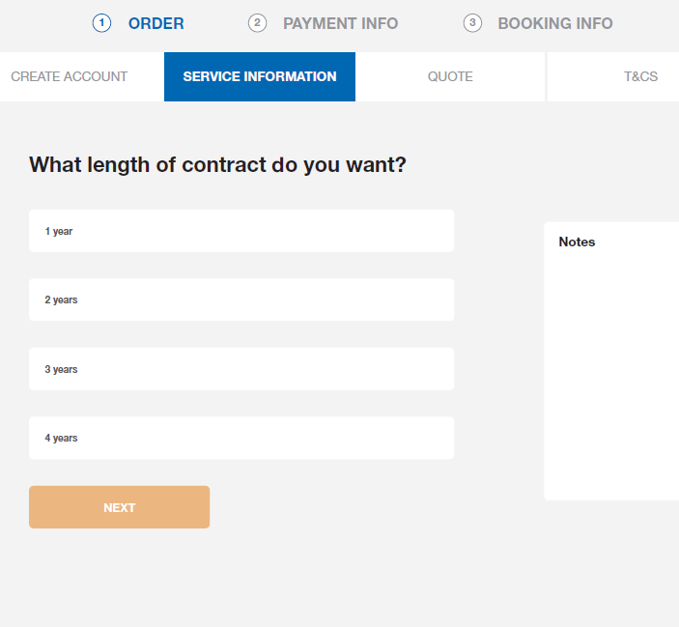
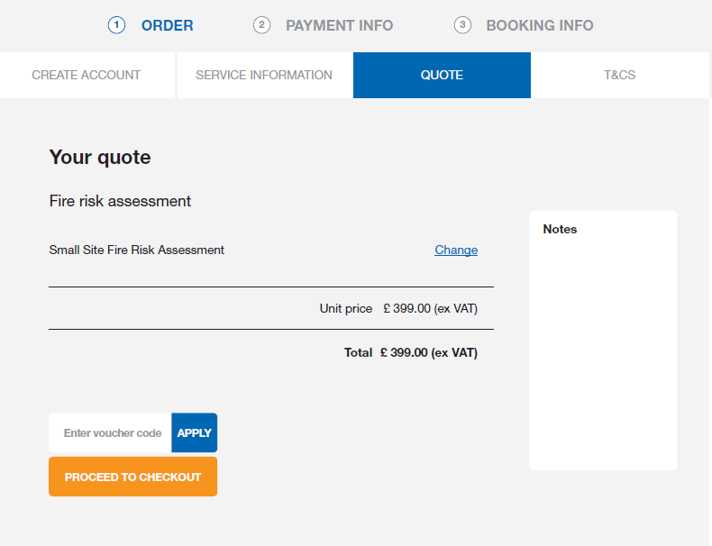
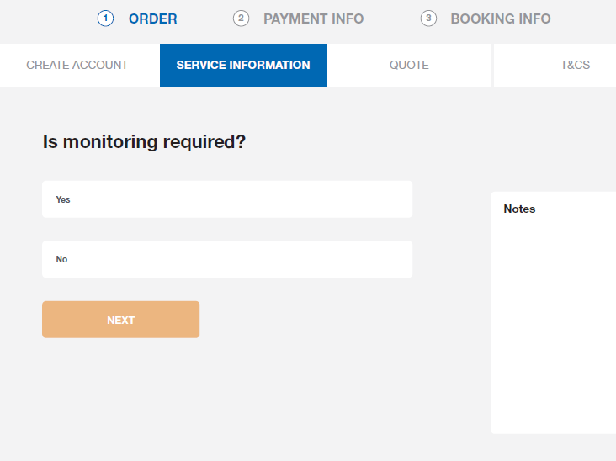
Proposed Purchase Flow

Slide 11
Project Scope and List of Features
Process | User(s) | PROS Capability | Smart CPQ Scope
Product catalog | Sales Users Managers | Search, compare and sell standard products and services | Up to five (5) service products Hierarchical navigation Built-in search functionality Built-in product comparison functionality Product availability control via optional validity dates on each catalog item
Configuration engine | Pricing analysts Sales Operations Managers | Build and manage business rules for configuring products for selling | Dynamic constraint engine driving real-time management of business rules and options Rich predefined library of constraint types for a faster creation and deployment of products and an easier maintenance
Quotation process | Regional Sales Managers and Directors | Generate a 100% reliable quote in a few minutes for customer delivery | Allows for the following quotation processes: Spot quotes of standard catalog items Supports the entire quote lifecycle management process
Negotiation guidance | Sales Users Managers | Leverage Chubb-provided discount guidance | Display floor, target, and expert discount percentages during quotation process
Proposal generation | Sales Users and Regional Sales Managers and Directors | Generate branded sales proposals | Output in Adobe PDF format Detailed product information on each line item Retrieve and merge customer information from salesforce.com or Microsoft Dynamics Include Chubb-specific logo Include Chubb-specific address Include Chubb-specific terms and conditions
Product images and “rich media” | System Administrators | Attach images and PDF and other documents to catalog items | Chubb has the capability to load and associate product images and User manuals, etc., with each catalog item
Price and discount management | System Administrators | Set price and allowable discounts for each standard catalog item | Up to three (3) prices for each product Chubb can set a list price, catalog price, floor discount %, target discount %, and expert discount % on each standard catalog item

Slide 12
Agenda Kick Off Day Two
1
[09:00 – 12:00] Master, Pricing and Other Reference Data Discovery (Jason)
2
[12:00 – 13:00] Lunch (All)
3
[13:00 – 16:00] Quoting/CPQ Initial Solution Design Workshop (Jason)
4
[16:00 – 17:00] Review Action Items/Next Steps (All)

